Slide 1


Proposal Defense
Team
Aun Ali 22F-3097
Faheem Nawaz 22F-3742
Qaim Ali 22F-3142

Slide 2
Introduction
Our project “PAB MRI” introduces an intelligent, semi-automated framework designed to assist radiologists in interpreting Magnetic Resonance Imaging (MRI) scans with greater accuracy and efficiency. The system addresses key challenges in radiology, including labor-intensive workflows, time constraints, and the risk of human error. By leveraging advanced medical imaging analysis and AI-driven report generation, the framework focuses on region-specific diseases and ensures clinical precision. Seamless integration with existing reporting systems allows the solution to deliver expert-level decision support and timely diagnostic insights, ultimately reducing delays and enhancing the quality of patient care.

Slide 3
Outline (FYP Report v 1.0)
Project Vision
High-Level Diagram
High-Level Use Cases
Use Case Diagram
Expanded Use Cases
Expanded Use Case Diagram
Activity Diagrams
Sequence Diagram
System Sequence Diagrams
Class Diagram
ER Diagram for Databases

Slide 4
Project Vision
This project envisions transforming radiological diagnostics by providing intelligent, semi-automated support for MRI interpretation. Leveraging advanced deep learning techniques, the system analyzes medical images to detect region-specific abnormalities with clinical precision. It integrates seamlessly with existing reporting workflows, generating structured insights and prioritizing critical findings to assist radiologists in high-pressure environments. By reducing diagnostic delays and minimizing human error, the framework empowers healthcare professionals to make faster, more informed decisions

Slide 5
High-Level Diagram
Use Case ID | Use Case Name | Type | Actor | Description
HUC-01 | AI Report Generation | Primary | Radiologist, Model, Cloud Storage | Encompasses the entire automated pipeline from MRI input (upload, preprocessing, normalization, metadata extraction) to the use of VLM and LLM for generating a structured report draft.
HUC-02 | Clinical Review and Finalization | Primary | Radiologist | Covers the required human oversight loop, allowing the Radiologist to review, edit, approve, and export the AI-generated report, ensuring diagnostic accountability and compliance.
HUC-03 | Model Feedback and Improvement | Secondary | Radiologist, Model | Manages the explicit mechanism for the Radiologist to provide qualitative and quantitative feedback on the AI's performance, which is essential for continuous model retraining and evaluation.
HUC-04 | System and User Administration | Secondary | Admin, Cloud Storage | Manages system-level functionality, including secure user authentication, account management, auditing system activity logs, and monitoring overall system health and notifications.

Slide 6
High-Level Use Cases
AI Report Generation - Radiologist, Model, Cloud Storage
Clinical Review and Finalization - Radiologist
Model Feedback and Improvement - Radiologist, Model
System and User Administration - Admin, Cloud Storage

Slide 7
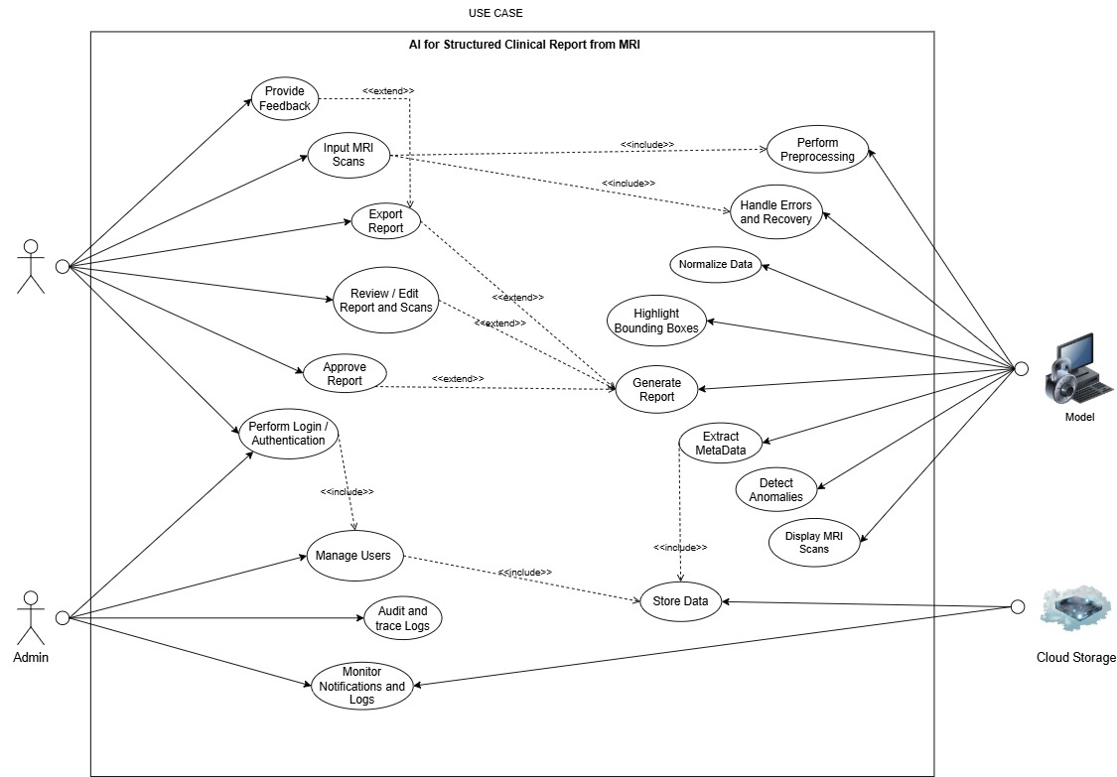
Use Case Diagram

Slide 8
Expanded Use Cases
Perform Login / Authentication - Radiologist, Admin
Input MRI Scans – Radiologist
Review / Edit Report and Scans – Radiologist
Approve Report – Radiologist
Export Report – Radiologist
Provide Feedback – Radiologist
Display MRI Scans - Radiologist, Model
Generate Report – Model
Manage Users - Admin, Cloud Storage
Audit and Trace Logs - Admin, Cloud Storage
Monitor Notifications and Logs – Admin
Perform Preprocessing – Model
Handle Errors and Recovery - Model, Radiologist
Normalize Data – Model
Highlight Bounding Boxes - Model

Slide 9
Expanded Use Case Diagram # 1
Field | Description
Use Case ID | UC-02
Use Case Name | Input MRI Scans
Type | Primary
Actor | Radiologist
Description | Allows the Radiologist to upload raw MRI files (e.g., DICOM) into the system for AI processing.
Trigger | Radiologist selects the option to add a new scan.
Pre-Condition | Radiologist is logged in and authenticated (UC-01).
Post-Condition | MRI scan and metadata are successfully stored, and the AI processing pipeline begins.
Normal Flow | 1. Radiologist selects scan files. 2. System validates file format. 3. System uploads the file (includes Perform Preprocessing). 4. System confirms successful upload.
Alternative Flow | A. Invalid Format: 1. System rejects file and displays error message. 2. User is prompted to upload a supported file format.
Special Requirement | Must be compatible with DICOM, JPEG, and PNG formats.
Frequency of Use | High
Assumption | Network connection is stable for large file uploads.

Slide 10
Expanded Use Case Diagram # 2
Field | Description
Use Case ID | UC-03
Use Case Name | Review / Edit Report and Scans
Type | Primary
Actor | Radiologist
Description | Allows the Radiologist to view the AI-generated report draft, edit text, and view visual grounding (annotations) on MRI images.
Trigger | Radiologist navigates to a report with “Pending Review” status.
Pre-Condition | Report draft must be generated (via UC-08).
Post-Condition | Report draft is updated and saved with the Radiologist’s edits.
Normal Flow | 1. Radiologist opens report draft. 2. System loads report and associated scans (UC-07). 3. Radiologist edits text/annotations. 4. Radiologist saves the updated draft.
Alternative Flow | A. Cancellation: 1. Radiologist exits without saving. 2. System maintains previously saved draft.
Special Requirement | Edits must be traceable (Audit Trail). Must be completed within 15 seconds.
Frequency of Use | High
Assumption | Radiologist has necessary medical expertise to review the report.

Slide 11
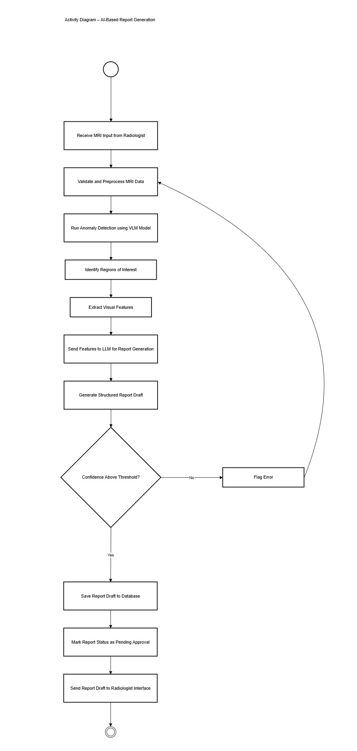
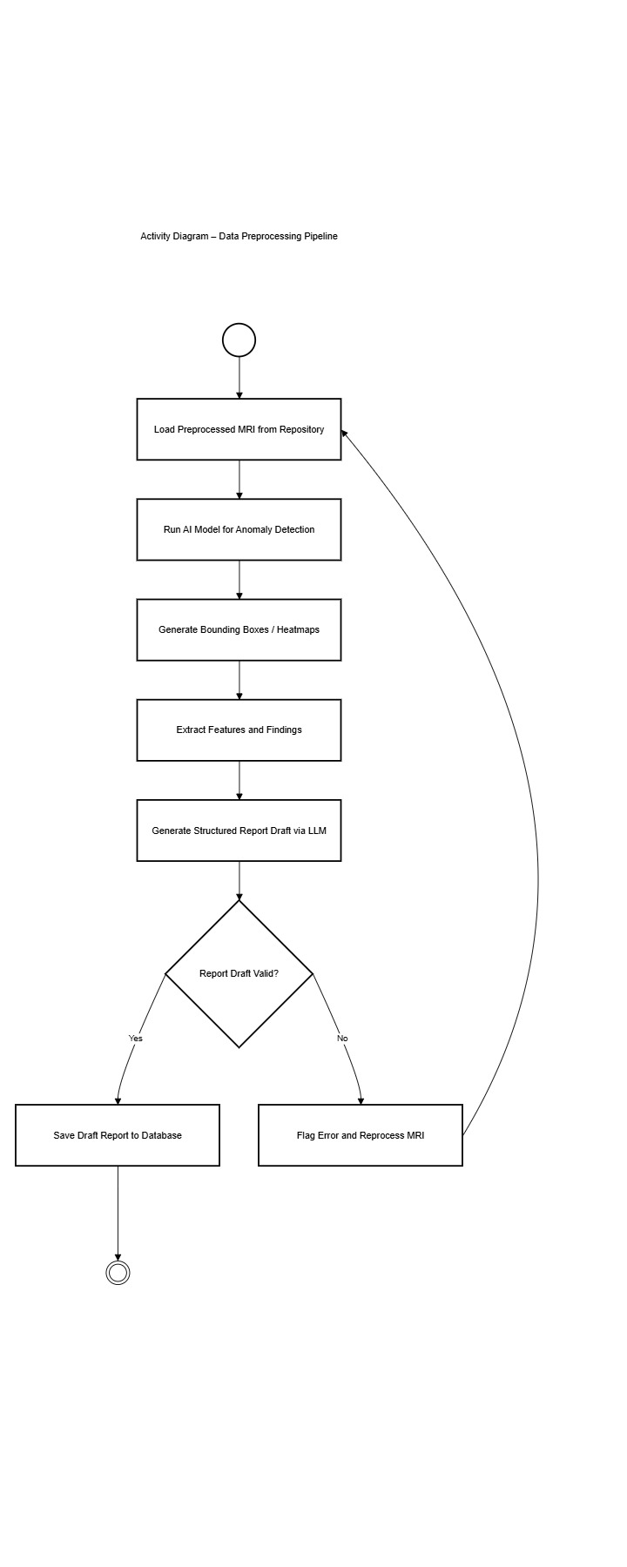
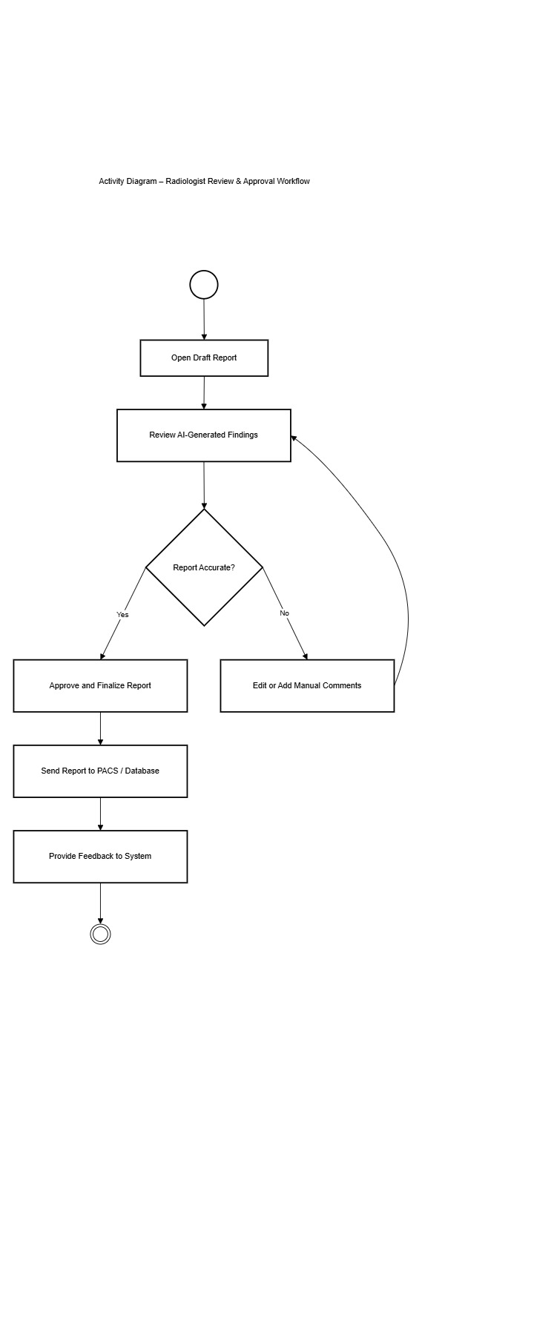
Activity Diagrams

Slide 12
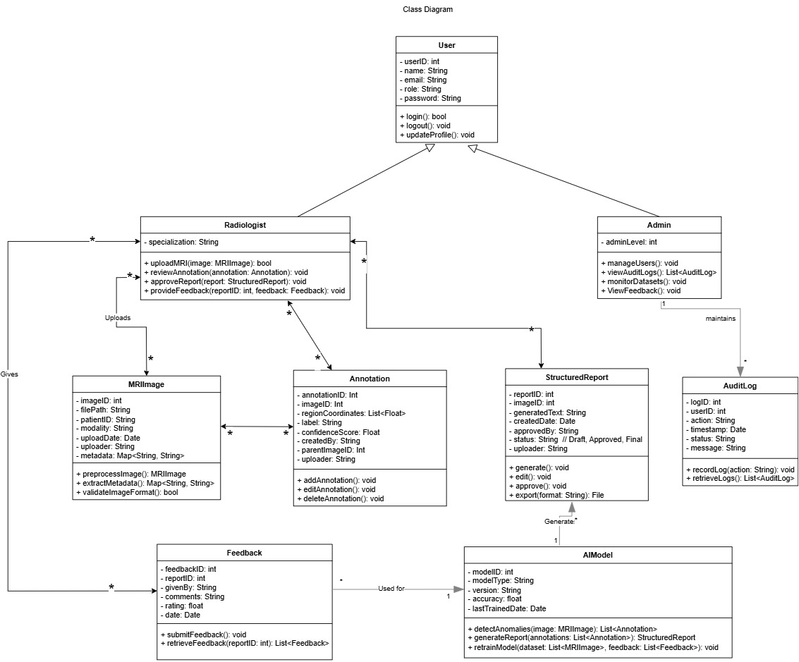
Class Diagram

Slide 13
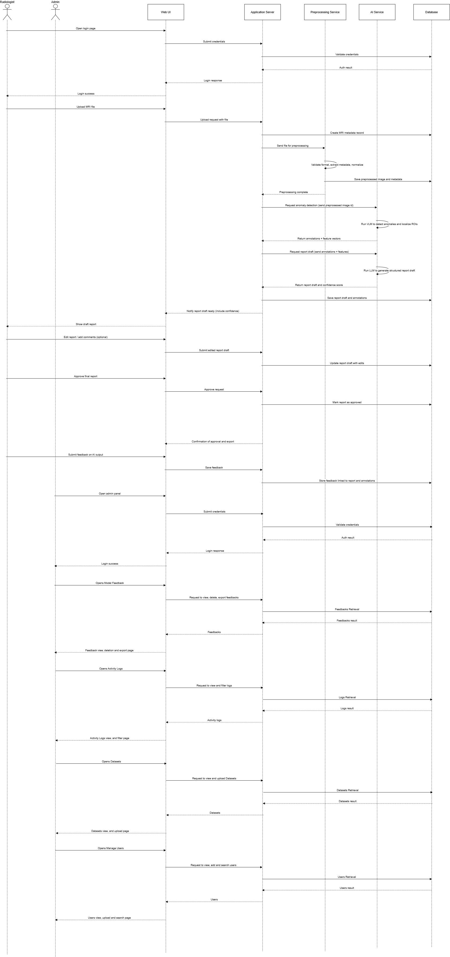
Sequence Diagram

Slide 14
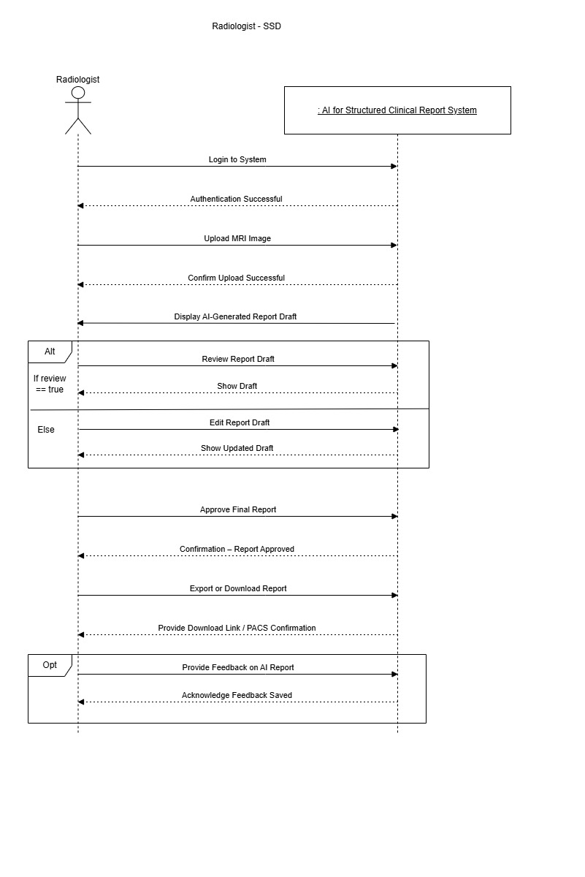
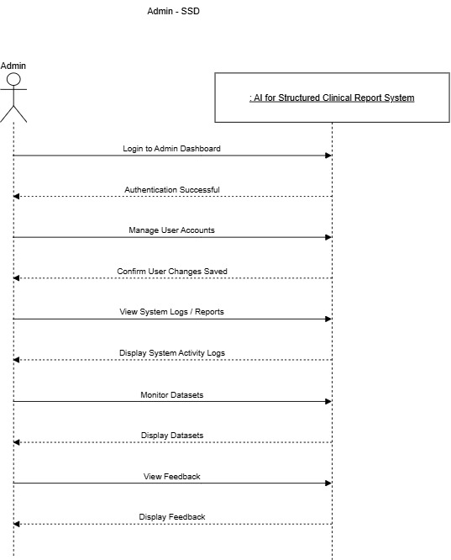
System Sequence Diagrams

Slide 15
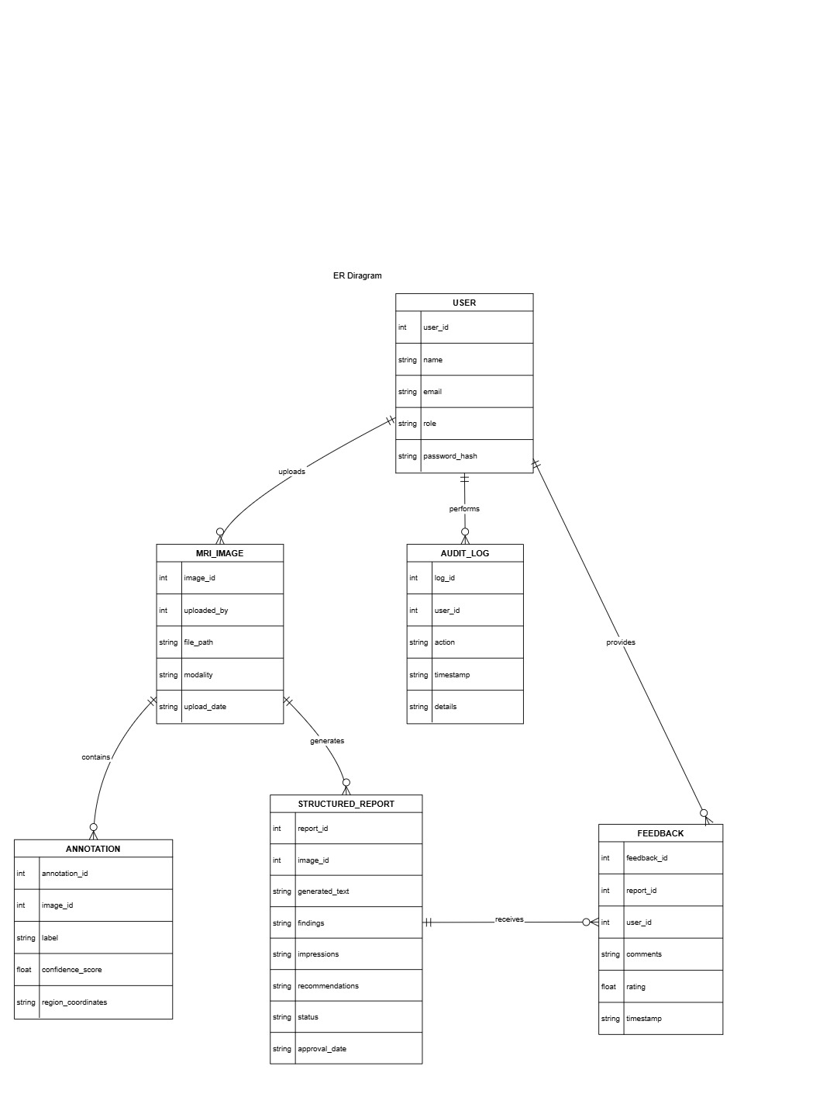
Entity Relationship Diagram (ERD)

Slide 16
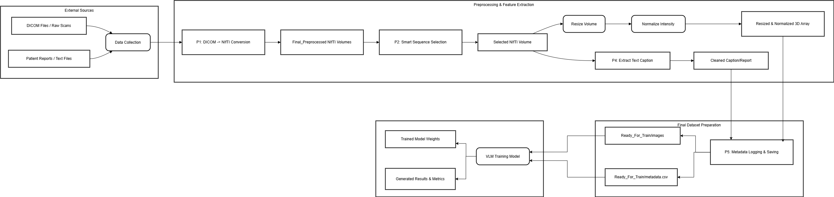
Flow of the Data

Slide 17
Thank You!

